Slide 1
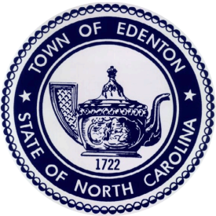
Planning for Community Redevelopment

Slide 2
Owner Action vs. Town Action
Private Abatement (14)
Council-Authorized Abatement (3)

Slide 3
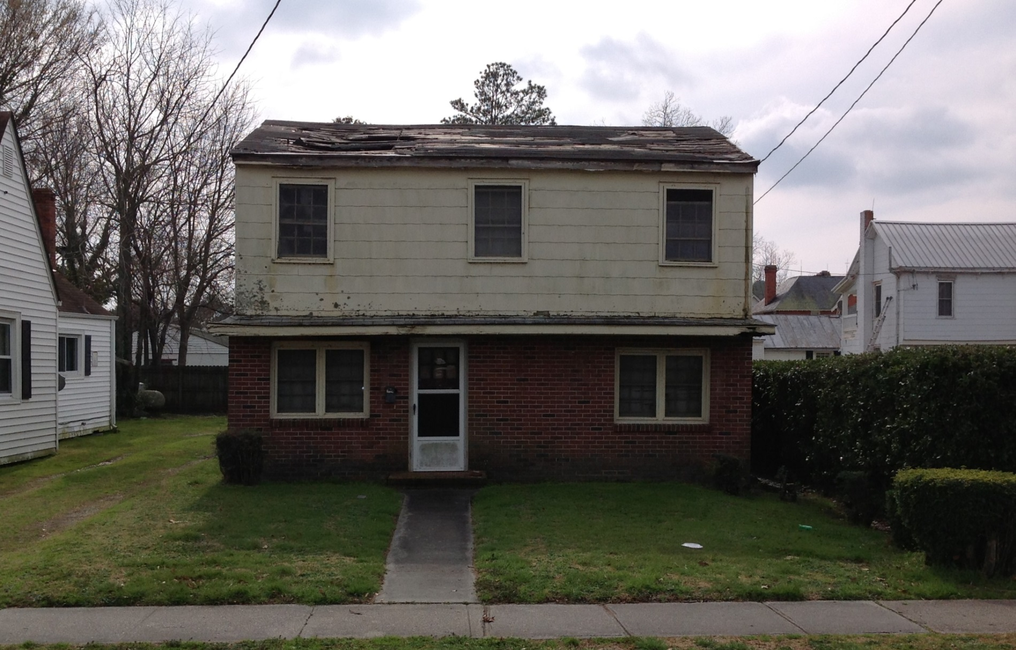
102 East Freemason Street Demolition
COMPLETE

Slide 4
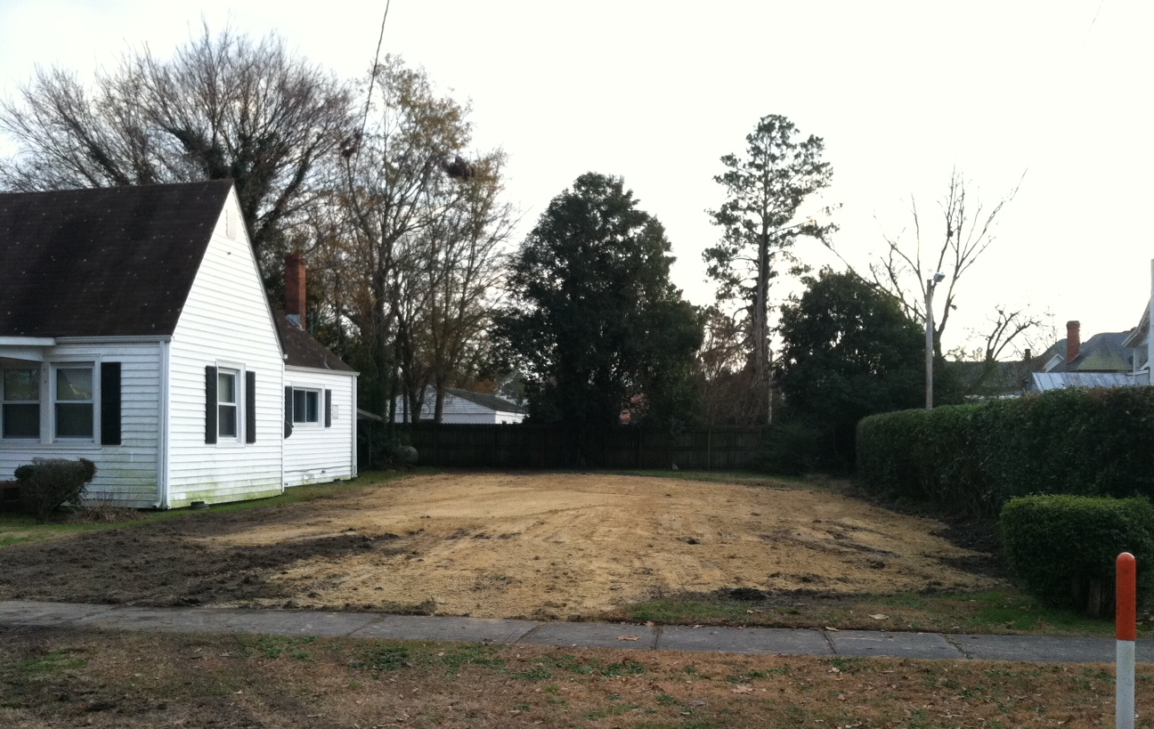
102 East Freemason Street Demolition
COMPLETE

Slide 5
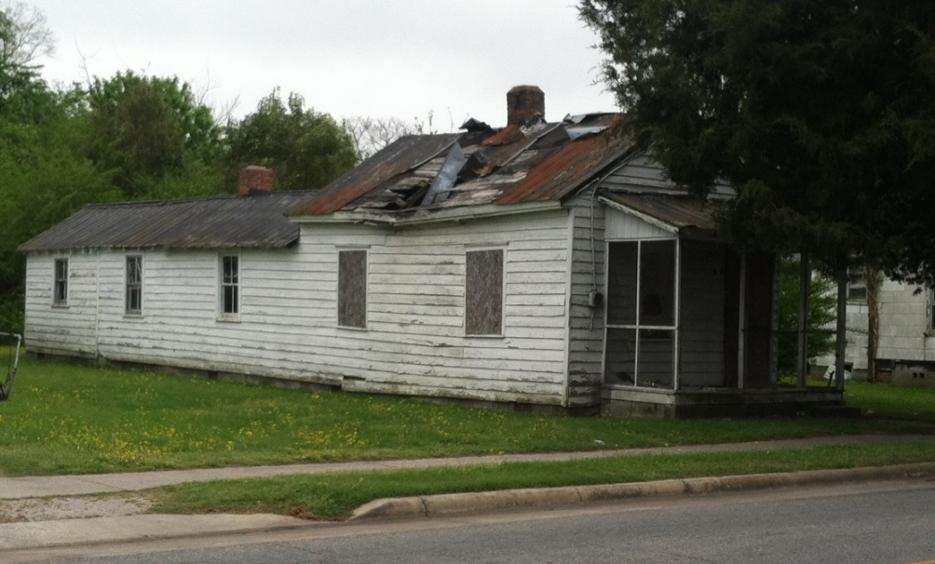
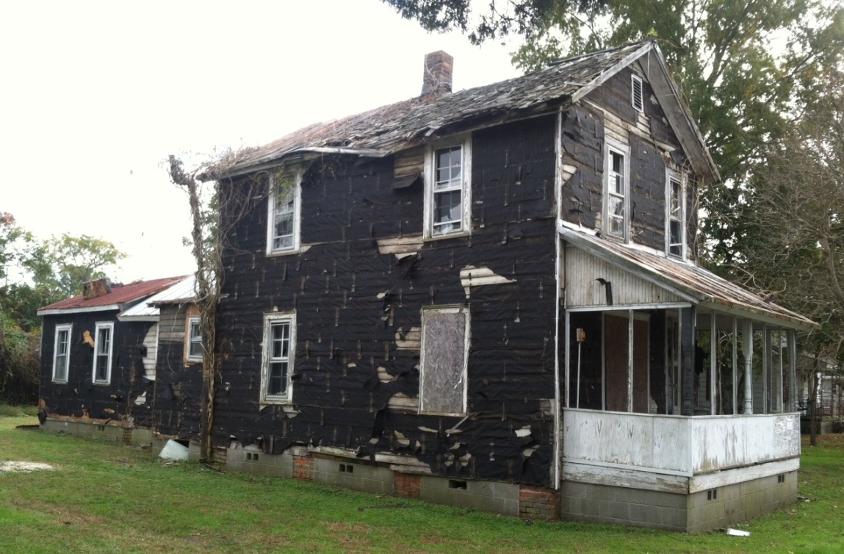
506 & 510 North Oakum – Demolition
506 N Oakum Street
510 N Oakum Street
Lot to be donated for house relocation to further Police Department project

Slide 6
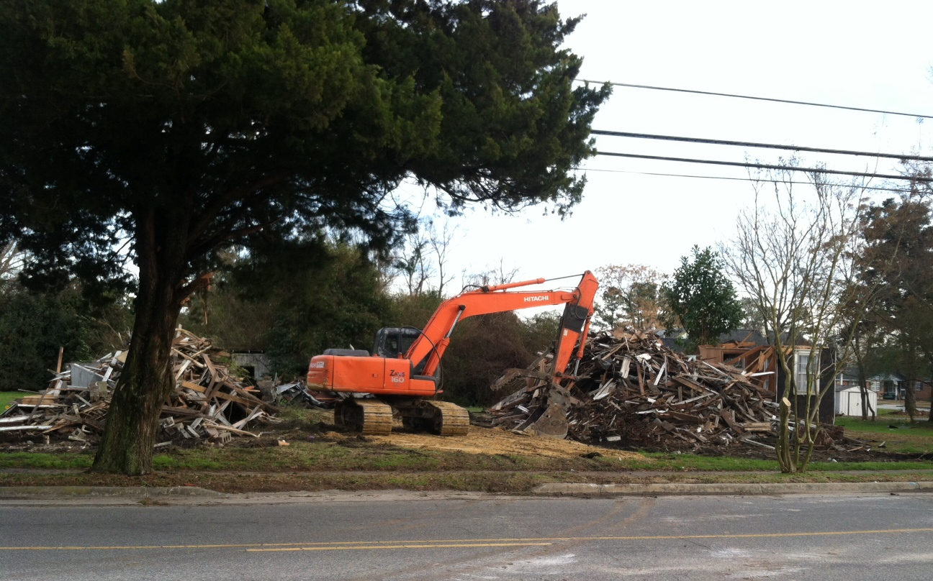
506 & 510 North Oakum Street Demolition - COMPLETE

Slide 7
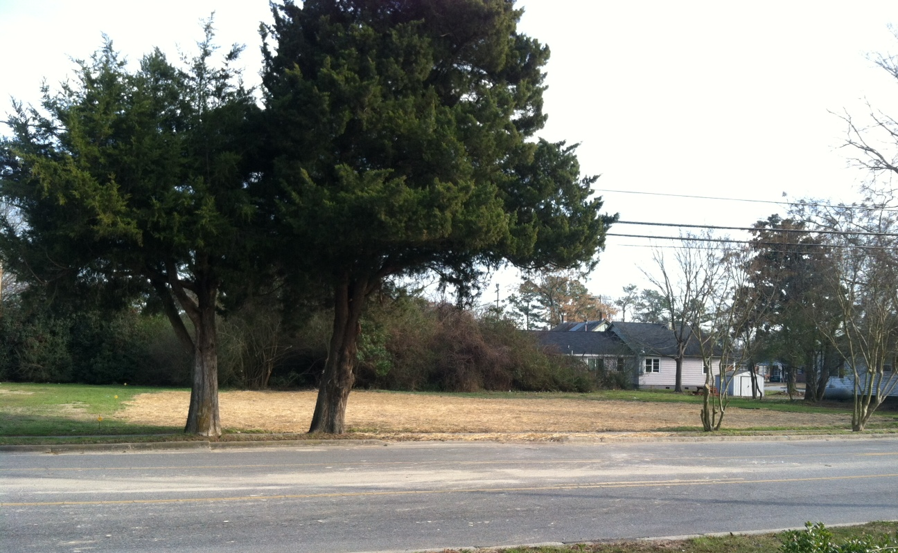
506 & 510 North Oakum Street Demolition - COMPLETE

Slide 8
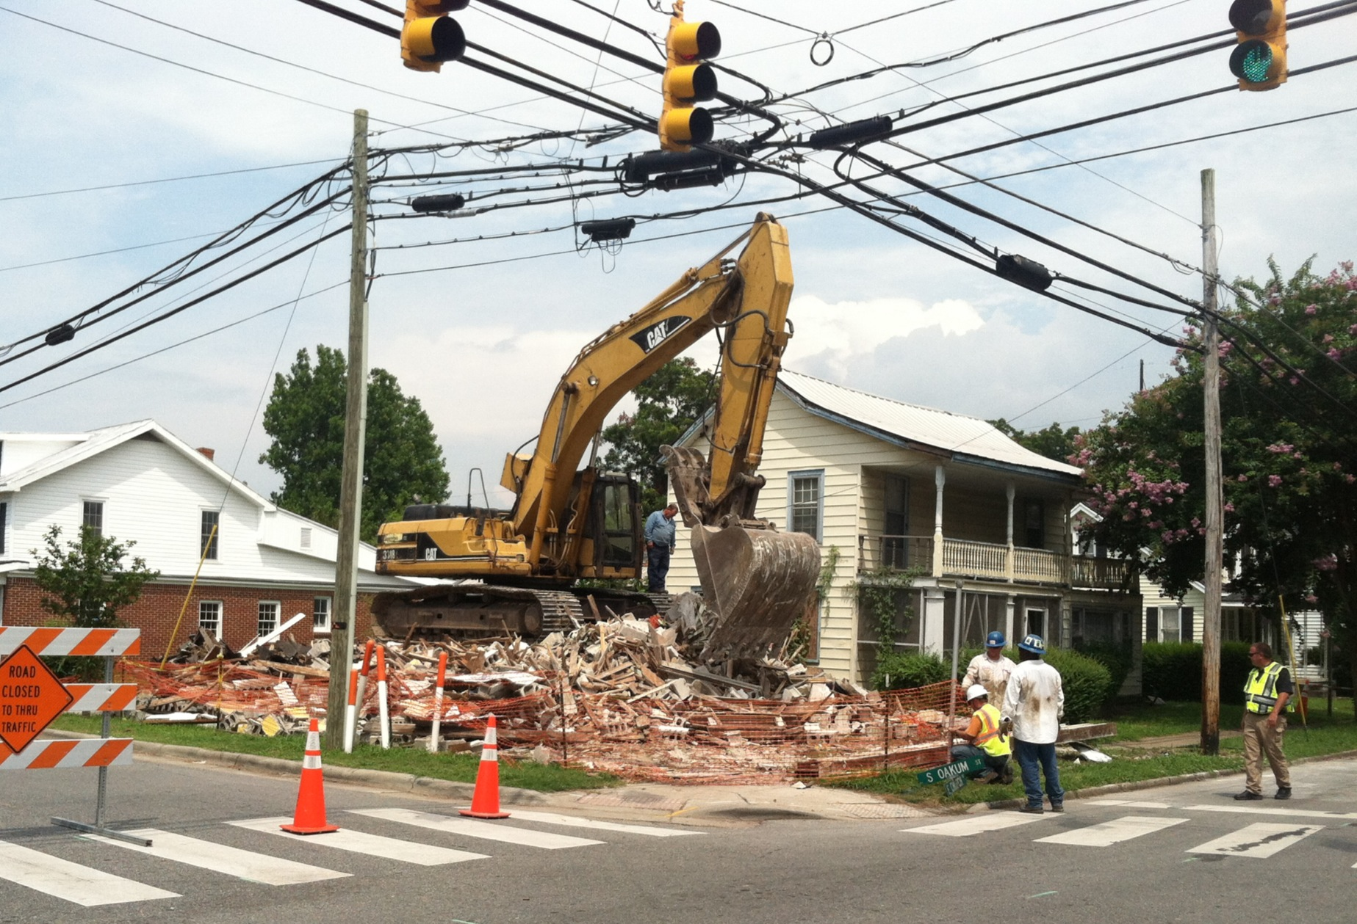

Slide 9
Root Causes of Blight
Rural towns – Urban opportunities
Decline of textile manufacturing jobs
Lack of knowledge – estate planning
Policy changes - CDBG housing funding

Slide 10
Town tries to Fight Back
Part-time Nuisance Code Enforcement Officer
Police Department – Broken Window Philosophy
Expanded National Historic Register
Adopted Prevention of Demolition By Neglect Code

Slide 11
Opportunity Knocks
Edenton to Build a new Police Station
“Place the Station in a location where it will do the most good”
Town Council embraces good planning

Slide 12
Neighborhood Redevelopment Plan

Slide 13
Planning
Neighborhood Redevelopment Plan
Consultant hired – Holland Consulting Planners
Mayor appointed citizens advisory committee
neighbors
dean of community college
faith based community
Preservation NC

Slide 15
Existing Conditions of Neighborhood
Demographics
Housing Conditions Survey
Land Use & Urban Form
Transportation
Zoning

Slide 16
Demographics
2010 Census Data Study Area Edenton
Total Population 1,041 5,004
2010 Median Age 41.5 43.7
Median Household Income $18,007 $24,773
No vehicle available 31% 26%
Median Cash Rent $481 $449
Median Value of Owner
Occupied Housing Units $148,984 $139,224

Slide 17
Housing Inventory & Assessment
Survey Completed: 98 units
Standard Units: 28 (29%)
▪ No major repair required
Moderately Deteriorated
Units: 24 (25%)
▪ Repair Cost < 40% of Replacement Value
Severely Deteriorated Units: 21 (22%)
▪ Repair Cost > 40% of Replacement Value
Dilapidated Units: 23 (24%)
▪ Repair Cost > 80% of Replacement Value

Slide 18
Assessment of Land Uses
Primarily Residential
Scattered Neighborhood Commercial
Few Undeveloped Parcels
Urban Form
Traditional Neighborhood Design
Shallow Setbacks

Slide 19
Transportation

Slide 20
Walkability

Slide 22
Police Station Criteria
Eyes on the street, impacts on safety of neighborhood
Accessibility for citizens and neighborhood
Potential for neighborhood revitalization and stability
Site suitability and land costs

Slide 23
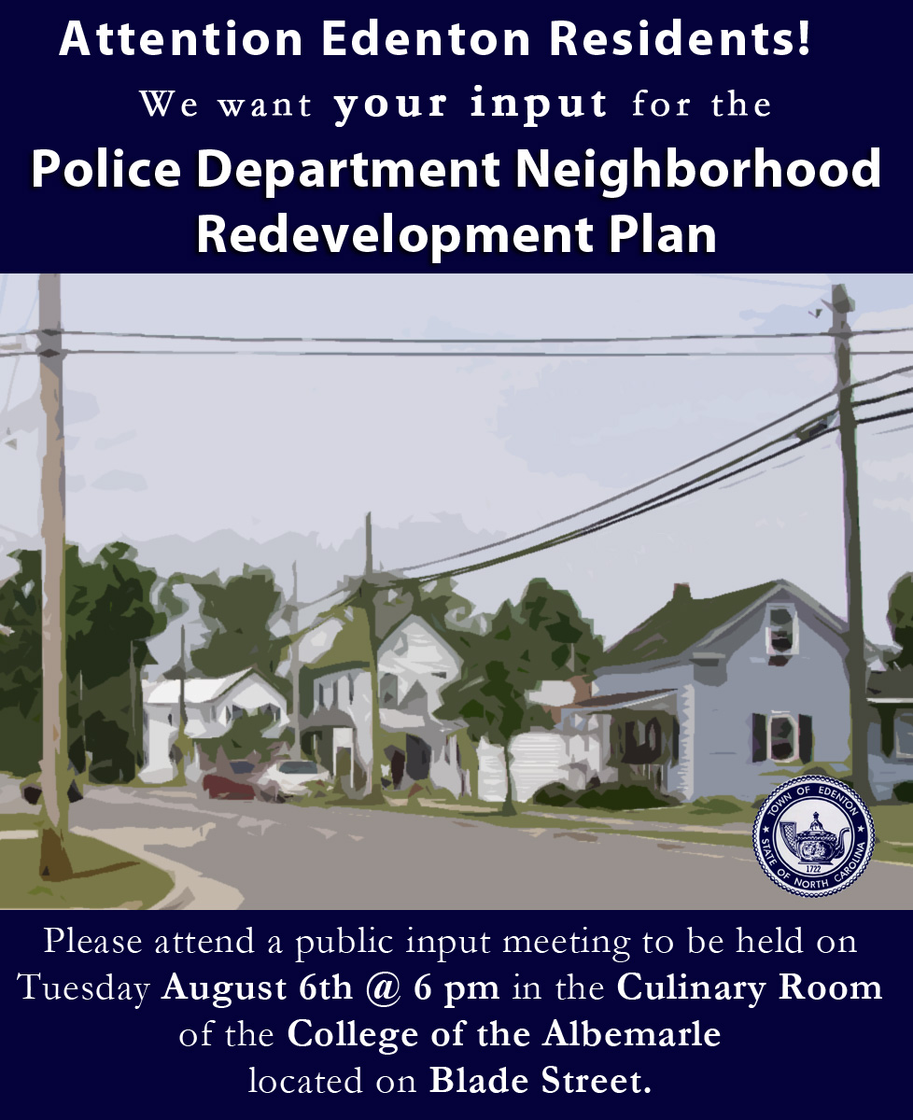

Slide 24
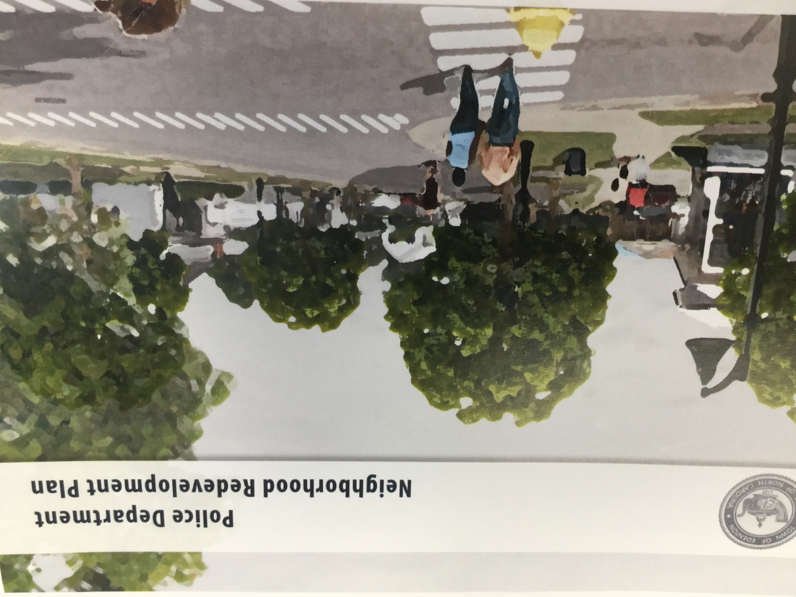

Slide 25
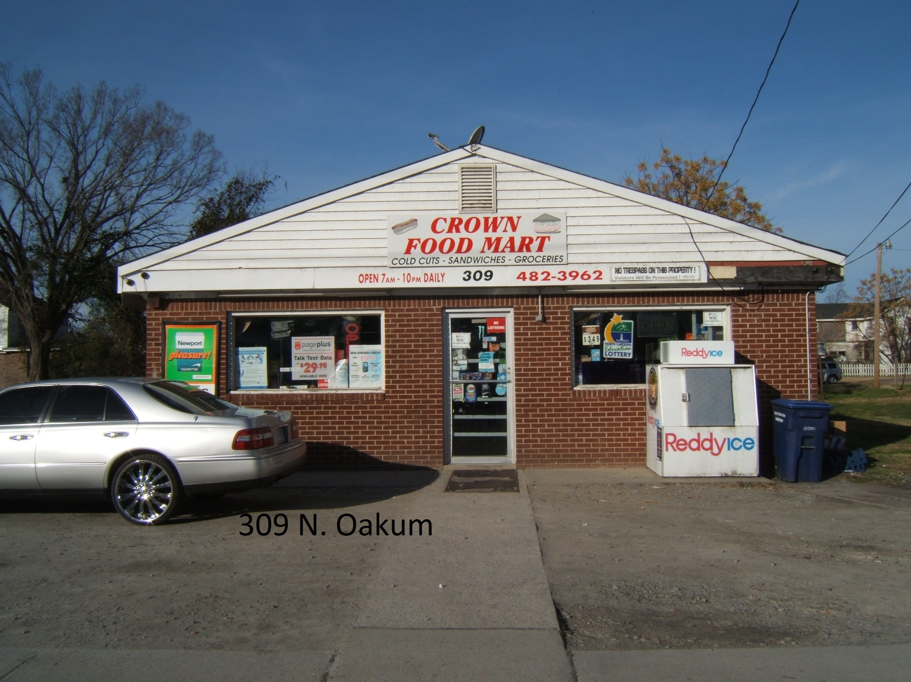

Slide 26
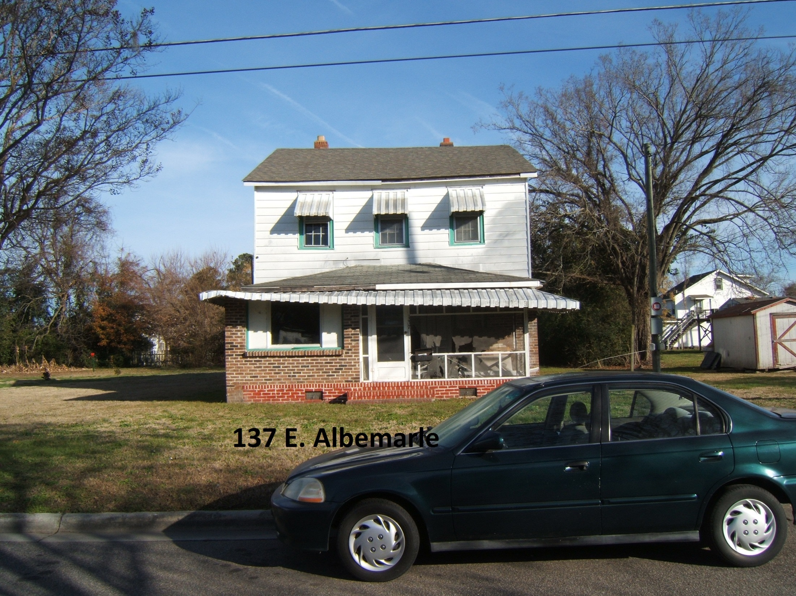

Slide 27
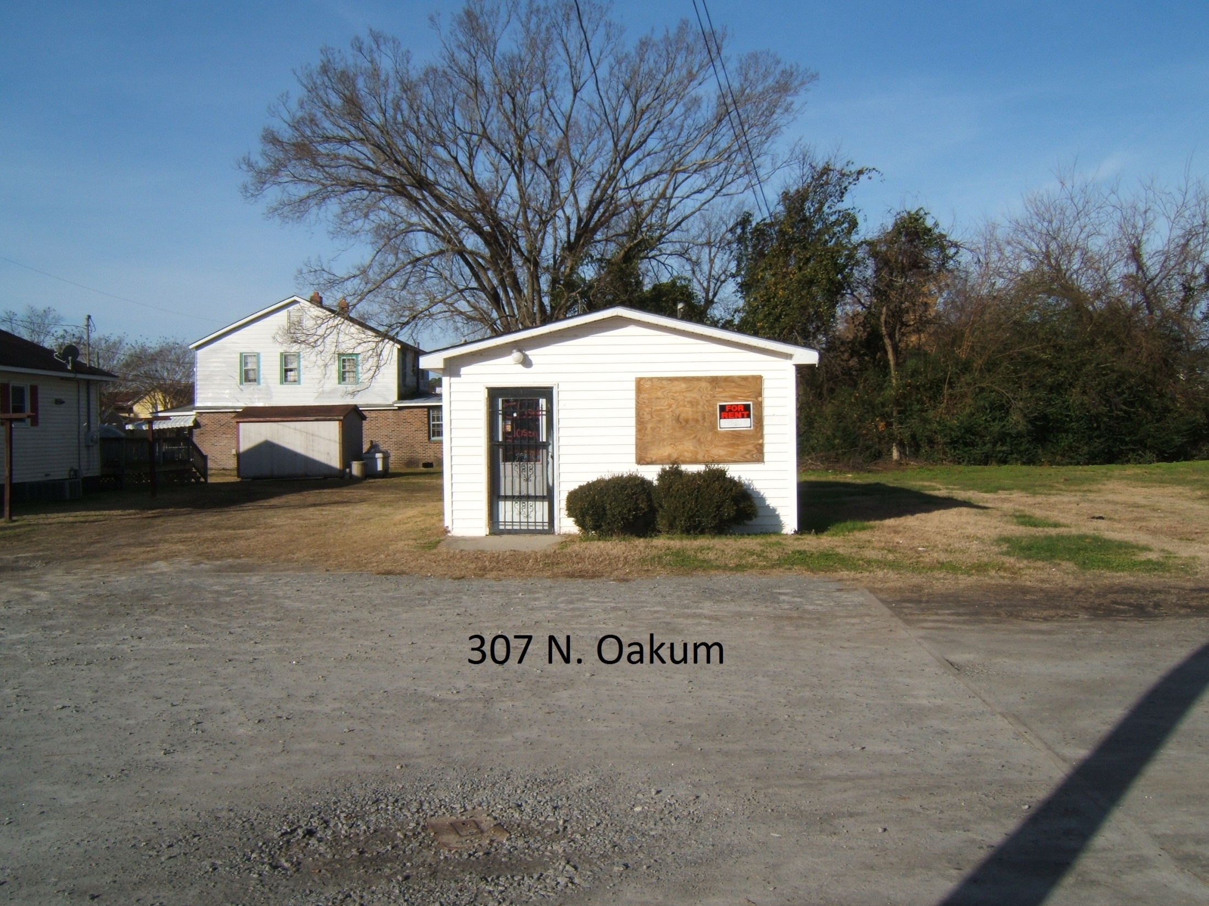

Slide 28
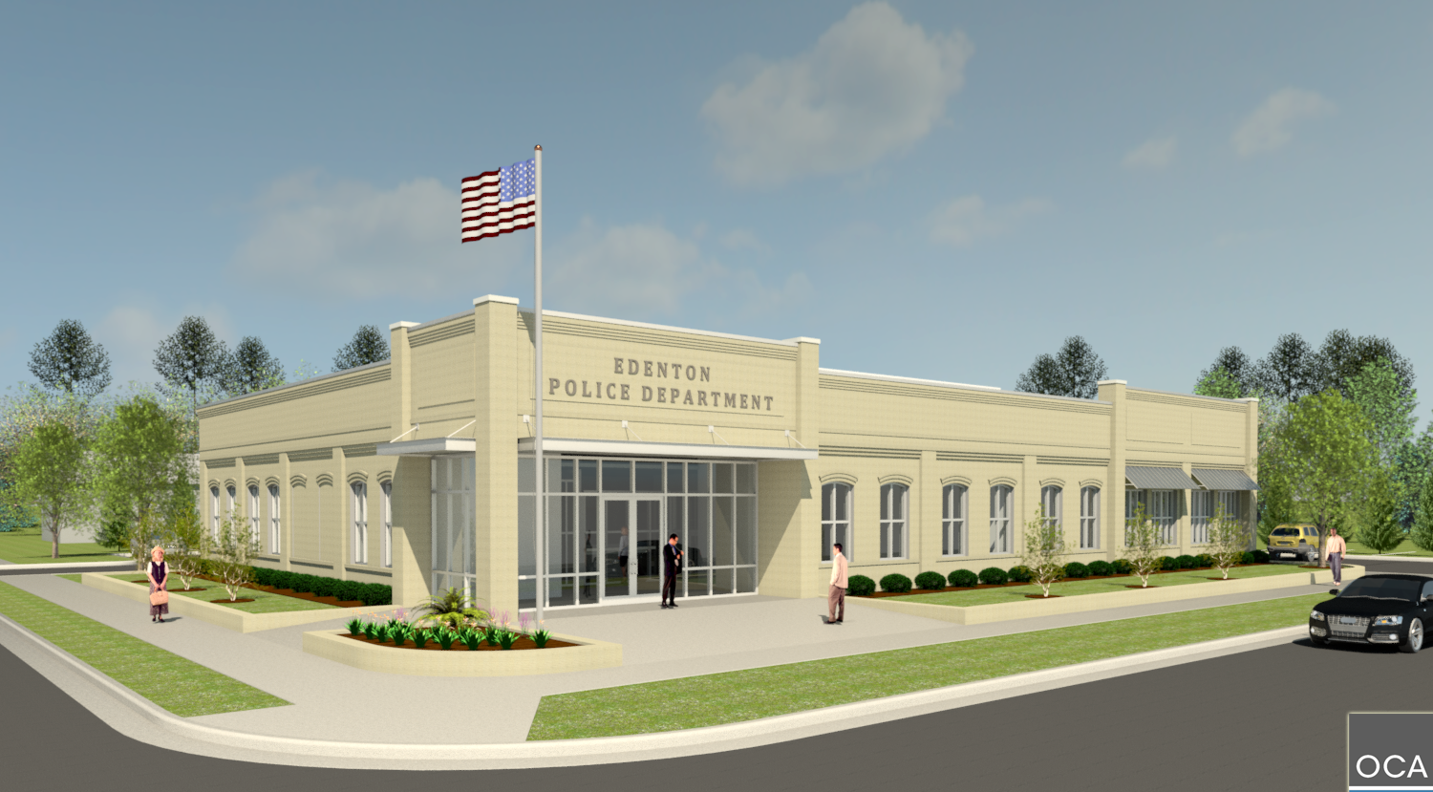

Slide 29
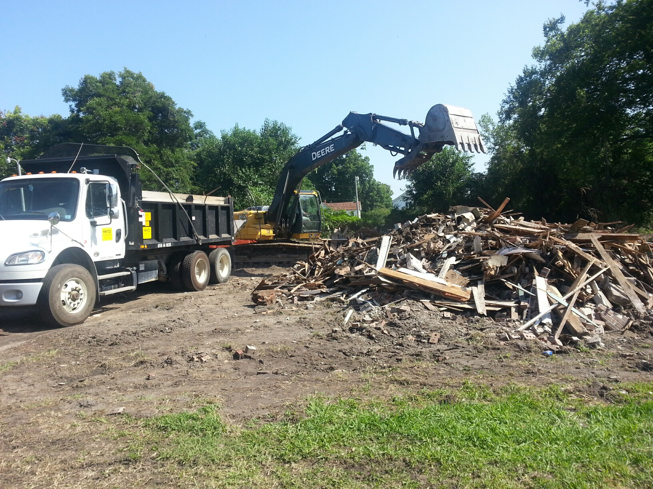

Slide 30
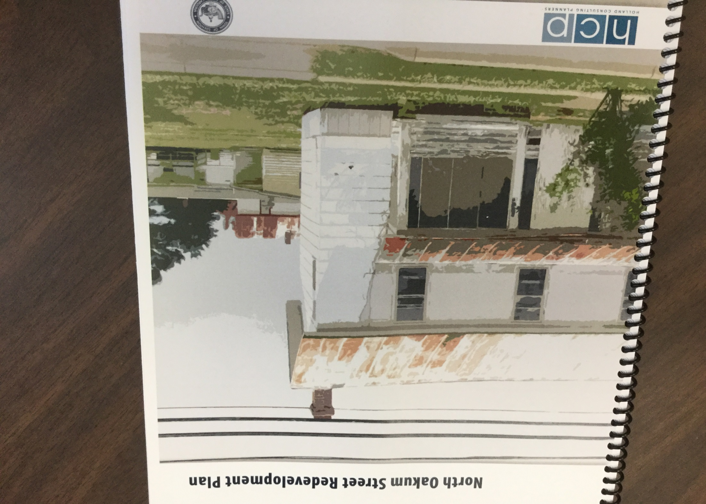

Slide 31
It’s all about Relationships
Neighborhood Meetings
Town Council meetings – invited neighbors
Planning Board meetings – invited neighbors
Public Hearings – positive feedback – buy in
Police, Fire and Public Works
Nuisance Code Enforcement

Slide 32
Allied Agencies & Friends
Preservation Commission
Habitat for Humanity
Neighborhood Policing Zones
NC Housing Finance Agency
USDA Rural Development
Baptist Men
National Main Street Center
National Fund for Sacred Places

Slide 33
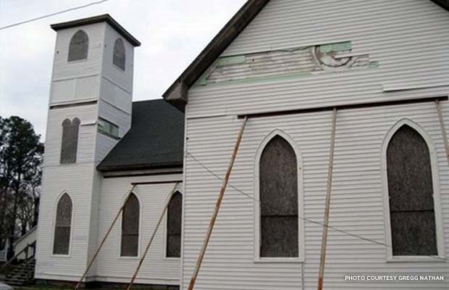
Kadesh African Methodist Episcopal Zion Church

Slide 34
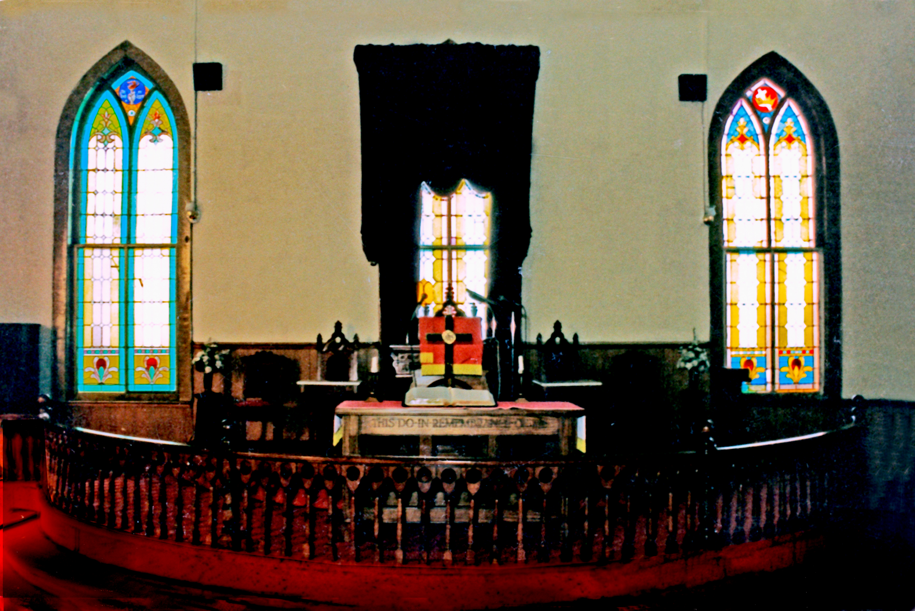
Circa 1897, built by Hannibal Badham, patriarch of a leading Edenton black family of builders

Slide 35
First two acquisitions in Redevelopment Zone
123 East Gale Street - three inquiries
136 East Albemarle Street – 5 inquiries
Yea, Sam!

Slide 36
Reflections
Strong Leadership & Commitment
Patience
Honest with and Responsive to Neighbors
Funding -$100,000 per year
Celebrate the baby steps
Investment spurs Investment
Police Officers excited to move in to the new neighborhood
Solar Farm Interconnect Revenues

