Slide 1
Edenton Human Relations Commission
Strengthening our community by promoting equality through activities and policies that foster mutual respect, inclusiveness and harmony among all of our citizens
Report to Mayor and Town Council
August 23, 2021

Slide 2
Timeline of Commission’s Work
January – February 2021 Workshop Style Training Sessions
Visions, Inc. provided guidelines for authentic conversations, enhancing racial harmony, bridging racial gaps
Visions, Inc. provided overview of strategies that focus on change: Institutional, Personal, Interpersonal and Cultural

Slide 3
Timeline of Commission’s Work
February – March 2021 Group Work
Commission identified & reviewed 27 initiatives/goals
Commission aligned initiatives with the four Focus of Change Categories: Institutional, Personal, Interpersonal and Cultural
Commission members participated in Group Values Checklist Exercise
Commission Adopted Core Values that we use in governing ourselves

Slide 4
Timeline of Commission’s Work
March 2021 Affirmation of Core Values:
Honesty/Integrity
Truth Seeking
Faith/Love
Diversity; Unity/Community
Compassion/Empathy

Slide 5
Timeline of Commission’s Work
April 2021 – May 2021 Internal Goal: History of
Confederate Monument
Town Attorney briefed Commission on NC General Statute Sec. 100-2(b), Monuments, Memorials and Parks
Law prohibits removal, relocation or alteration however there are exceptions to the law
Shepard-Pruden Memorial Library Librarian briefed Commission on research compiled as part of the celebration of the 350th anniversary of Chowan County entitled “365 days of Black History in Edenton & Chowan County”.

Slide 6
Timeline of Commission’s Work
June 2021 Commission members discussed at length the significance the monument held for them personally.
Some Commission members felt the monument represents racism & division, grounded not only in the slavery of Civil War era, but also serves as reminder of their own pain experienced as citizens of Edenton. These members expressed need for healing, which they felt could not begin until the monument is removed.

Slide 7
Timeline of Commission’s Work
(Continuation) June 2021 Commission members discussed at length the significance the monument held for them personally
Other Commission members acknowledged the monument does represent a dark time in American history, but there is need to preserve that that history in order to learn more of the truth of what actually occurred and move forward in unity and restoration. Suggested the existing monument plot could be added to, perhaps with monument of equal significance, as well as communication that tells the story of Edenton residents as they seek to heal. The hope expressed was that there be a way to balance and complete Edenton’s local history, striving for equity and respect for all citizens.

Slide 8
Timeline of Commission’s Work
(Continuation) June 2021
Majority vote was to remove the monument. (Seven in favor, six opposed).
Commission reviewed options of where to relocate the monument
Recommend relocation to green space at rear of Beaver Hill Cemetery, subdivide property to create a memorial park for the monument

Slide 9
Timeline of Commission’s Work
July – August 2021
Recommend historical experts such as NC Department of Natural & Cultural Resources; Historic Edenton State Historic Site; Edenton Historical Commission; and Shepard-Pruden Memorial Library assist in a long-range plan to develop the proposed memorial park as well as the public space at the foot of S. Broad Steet which would become vacant after the monument is removed.
Both locations could become places of personal reflections and historic instruction for residents and visitors alike.

Slide 10
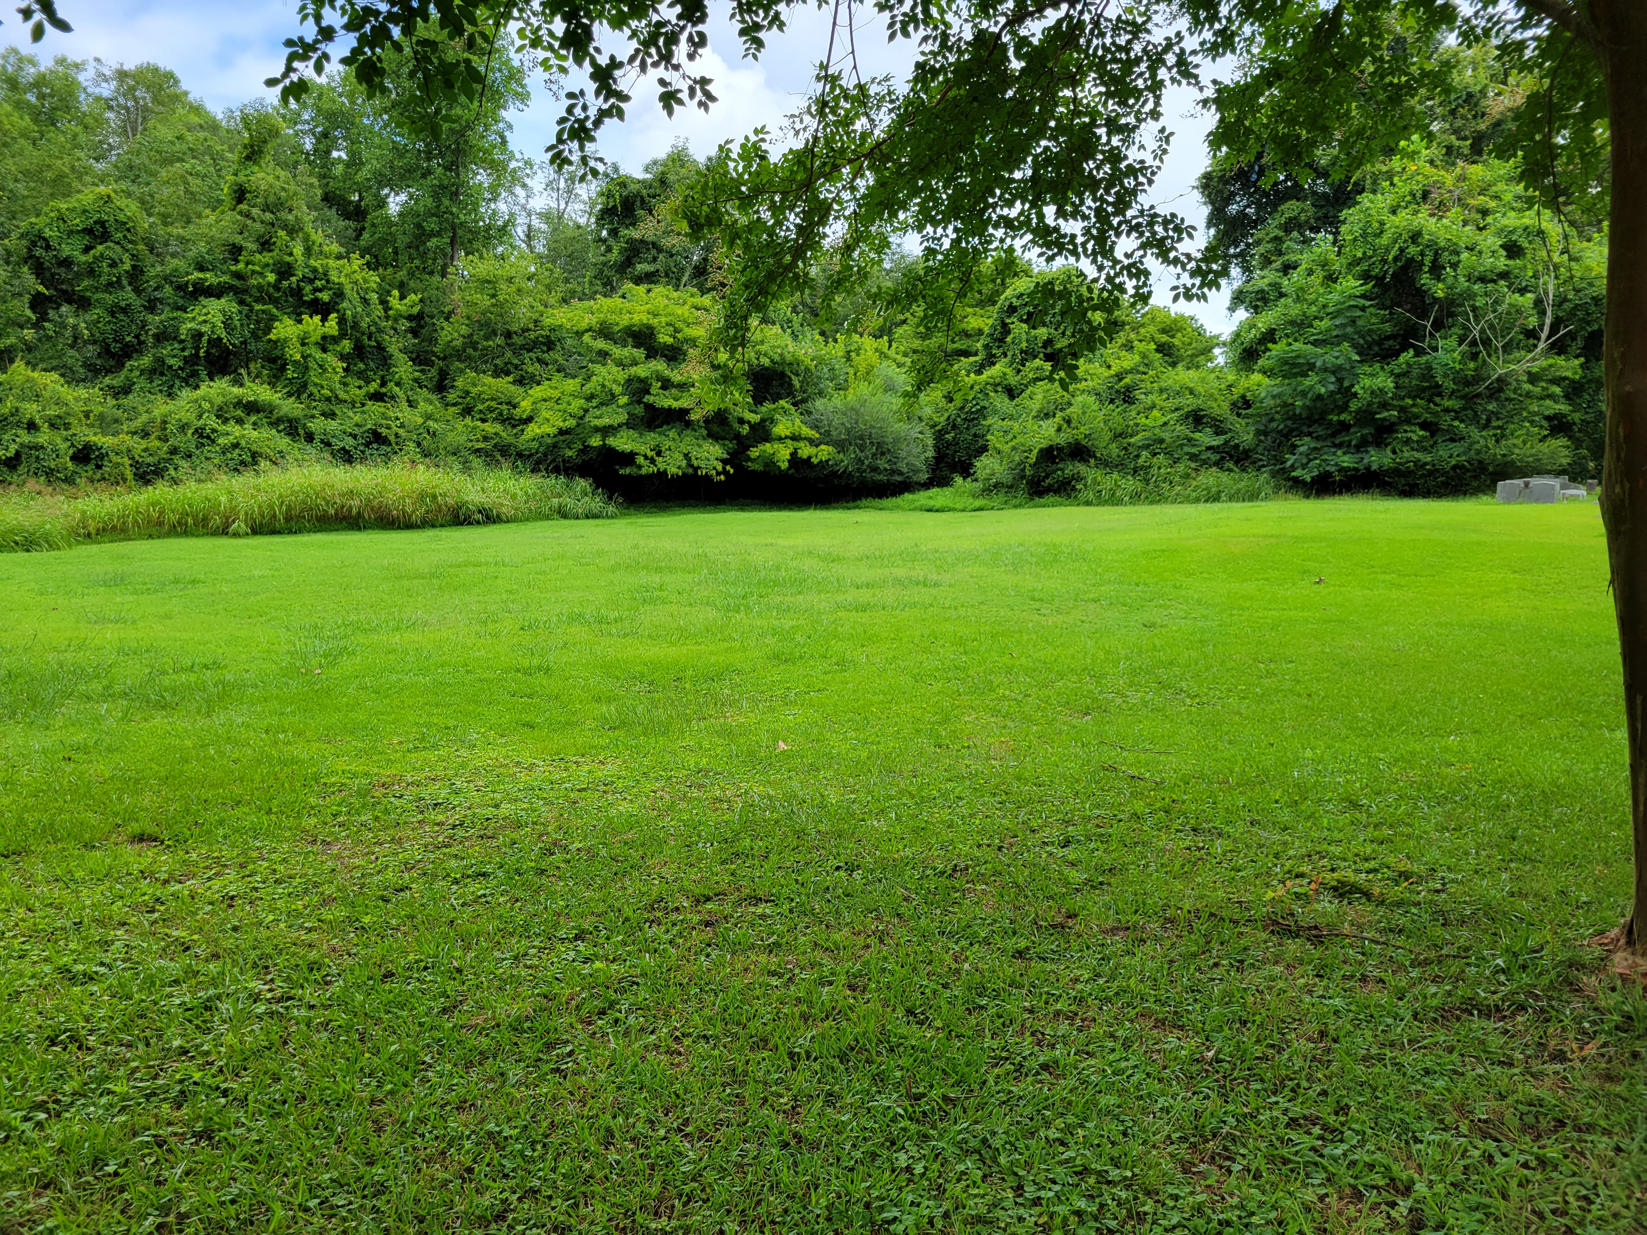
Timeline of Commission’s Work August 2021

Slide 11
Town Staff Report on Process for Certificate of Appropriateness and Minor Subdivision
Certificate of Appropriateness, Historic Preservation Commission
Minor Subdivision process:
Survey of property
Plat created of property
Minor subdivision reviewed by Land Use Administrator
Minor subdivision approved and recorded

Slide 12
Human Relations Commission
Respectfully request review report in its entirely; and
Respectfully request review Appendix A of Report, which includes electronic links to research, data & information Commission reviewed and took under consideration during our extensive deliberations.
Respectfully request mindfulness of the Commission’s Mission which Council so determined: Strengthening our community by promoting racial equality through activities & policies that foster mutual respect, inclusiveness and harmony among all of our citizens
Respectfully request mindfulness of the Commission’s Core Values: Honesty& Integrity; Truth Seeking; Faith & Love; Diversity; Unity & Community; and Compassion & Empathy.

